Slide 1
SIGNS WITH SMART CONNECTIVITY FOR BETTER ROAD SAFETY
TEAM LEADER : AASINA BARVEEN.A
TEAM MEMBER 1 : SANGEETHA .P
TEAM MEMBER 2 : VIGNESHWARI .P
TEAM MEMBER 3 : HARIDHARSHINI.R

Slide 2
1.INTRODUTION :
1.1 PROJECT OVER VIEW
IN PRESENT SYSTEMES THE ROAD SIGNS AND THE SPEED LIMITS ARE STATIC.BUT THE ROAD SIGNS CAN BE CHANGED IN SOME CASES .WE CAN COSIDER SOME CASES WHEN THERE ARE SOME ROAD DIVERSIONS DUE TO HEAVY TRAFFIC OR DUE TO ACCIDENTS THEN WE CAN CHANGE THE ROAD ACCORDINGLY IF THEY ARE DIGITALIZED .THIS PROJECT PROPOSES A SYSTEM WHICH HAS DIGITAL SPEED LIMITS ARE STATIC .

Slide 3
1.2PURPOSE
THE PROJECT PROPOSES A SYSTEM WHICH HAS DIGITAL SIGN BOARDS ON WHICH THE SIGNS CAN BE CHANGED DYNAMICALLY.IF THERE IS RAIN FALL THEN THE ROADS WILL BE SLIPPERY AND THE SPEED LIMITS WOULD BE DESCRASED.THERE IS A WEB APP THROUGH WHICH YOU CAN ENTER THE DATA OF THEROAD DIVERSIONS, ACCIDENT PRONE AREAS AND THE INFORMATION SIGN BOARDS CAN BE ENTERED THROUGH WEB APP.

Slide 4
2. LITERA TURE SURVEY
2.1 EXISTING PROBLEM
Many factors increase both the risk of road traffic crashes and the risk of death or injury they result in. Driving
at speed significantly increases both the likelihood of a crash occurring,and the severity of its consequences.for every 1% increase in mean speed there is a 4% increase in fatal crash risk.

Slide 5
2.2 REFERENCES :
2.3 PROBLEM STATEMENT DEFINITION :
THIS PROJECT WILL REPLACE THE STATIC BOARDS TO SMART SIGNED BOARDS THAT WILL CHANGE THE SPEED LIMITS ACCORDING TO THE WEATHER CLIMATE AND SHOW DIVERSION MESSAGES IF THERE IS ACCIDENTS IN THE ROAD AND ALERT IF THERE IS HOSPITAL,SCHOOL OR ANY ROADWORKS.

Slide 6
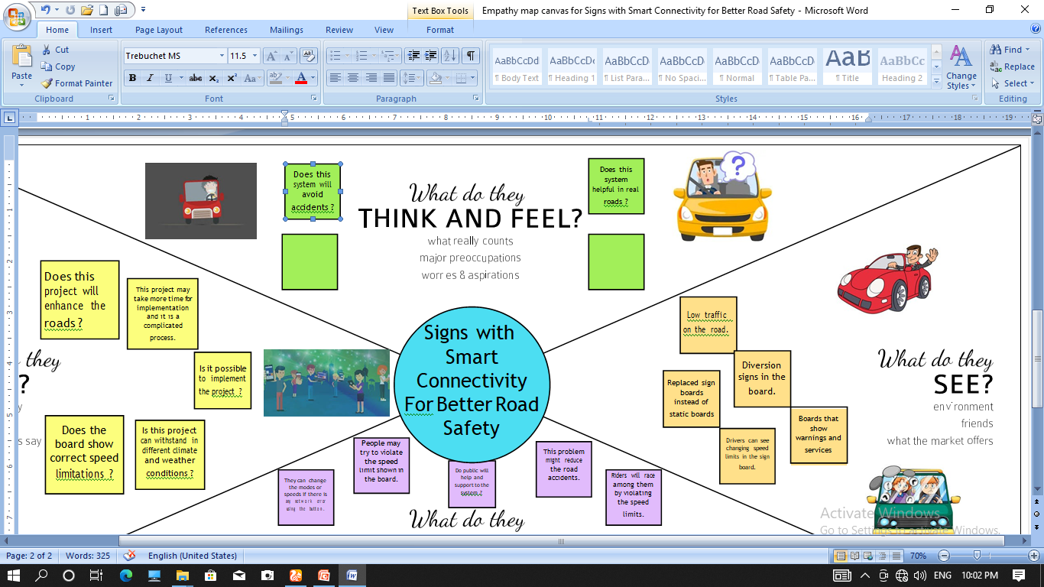
3.IDEATION & PROPOSED SLUTION :
3.1 EMPATHY MAP CANVAS

Slide 7
3.2 IDEATION & BRAINSTORMING :
High brightness signs are used to improve road safety
The sign boards have button mode and that button is used when there is no network connectivity.
Using PIR sensor,presence of a moving body is detected.so that while the traffic time on the crosswalks,auto traffic signals can be implemented.
During off peak hours weather based speed limit is avoided and the speed limits can be changed according to the traffic.
Weather report will be displayed in the sign board using the weather API

Slide 8
3.3 PROPOSED SOLUTION :
To replace the static signboards,smart connected sign boards are used.
These smart connected sign boards get the speed limitations froma webapp using weather API and update automatically.
Based on the weather changes the speed may increase or decrease.
Based on the traffic and fatal situations the diversion signs are displayed.
Guide(Schools),Warning and Service(Hospitals,Restaurant) signs area also displayed accordingly.

Slide 9
The weather and temperature details are obtained from the Open Weather Map API. Using these details, the speed limit will be updated automatically in accordance with the weather conditions. Also, the details regarding any accidents and traffic congestion faced on the particular road are obtained.Based on this,the traffic is diverted followed by a change in map path and the traffic is cleared.
By activating this button,either through the webapplication or the physical buttons, sign of the board can be changed accordingly, and the speed limit will also be set depending upon the zones. Also, the pedestrians are given an option to change the traffic signs if they want to cross the road. If the pedestrian presses the button that is present on the post at the end of the road, then the traffic will be analyzed immediately. Accordingly, the sign of the traffic signal will be changed. This inturn reduces the frequent changing ofthetraffic signs even ifthepedestriansare not present

Slide 10
3.4 PROBLEM SOLUTION FIT :
Highway Division
Passenger
Among its many duties, charge of keeping correct temperature sensor readings and informing the board of the speed of the customer’s vehicle.
Along roadways, static signs with clear direction are put as potential fixes.
As a teacher,the IOT cloud updates the smartboard on the condition of the roads on a regular basis.

Slide 11
We employ smart linked sign boards as an alternative to static signboards. With the help of a web app and weather API,these intelligent connected sign boards automatically.
The departments can receive direct emails or messge from customer.
clients will feel better after selecting an operation mode with the use of smartboard connectivity,and they will then follow the instructions on the smartboard.
The impact of the network on the tests was a significant and unexpected element.gives the quantity of sensors,this iot –based system was successful in simulation a large –scale smart sign board.

Slide 12
4. REQUIRMENT ANALYSIS :
4.1 FUNCTIONAL REQUIRMENT :
User visibility – sign boards be made of brights coloured LEDs capable of attracting drivers driver’s attention not too distracting to cause accidents.
User understanding – should display through means like images/illustration with text so that user can understand the sign correctly.
User convenience – display should be big enough to display all the signs correctlly so that it is visible even to far away drivers.

Slide 13
4.2 NON – FUNCTIONAL REQUIRMENTS :
Usability – should be able to dynamically update with respect to time.
Security – should be secure enough that only the intended messages are displayed in the display.
Reliability – should convey the traffic information correctly.
Performance – display should update dynamically whenever the weather or traffic value are update.
Availability – should be on a 24/7.
Scalability – should be modular and hence able to scale on servers horizontally.

Slide 14
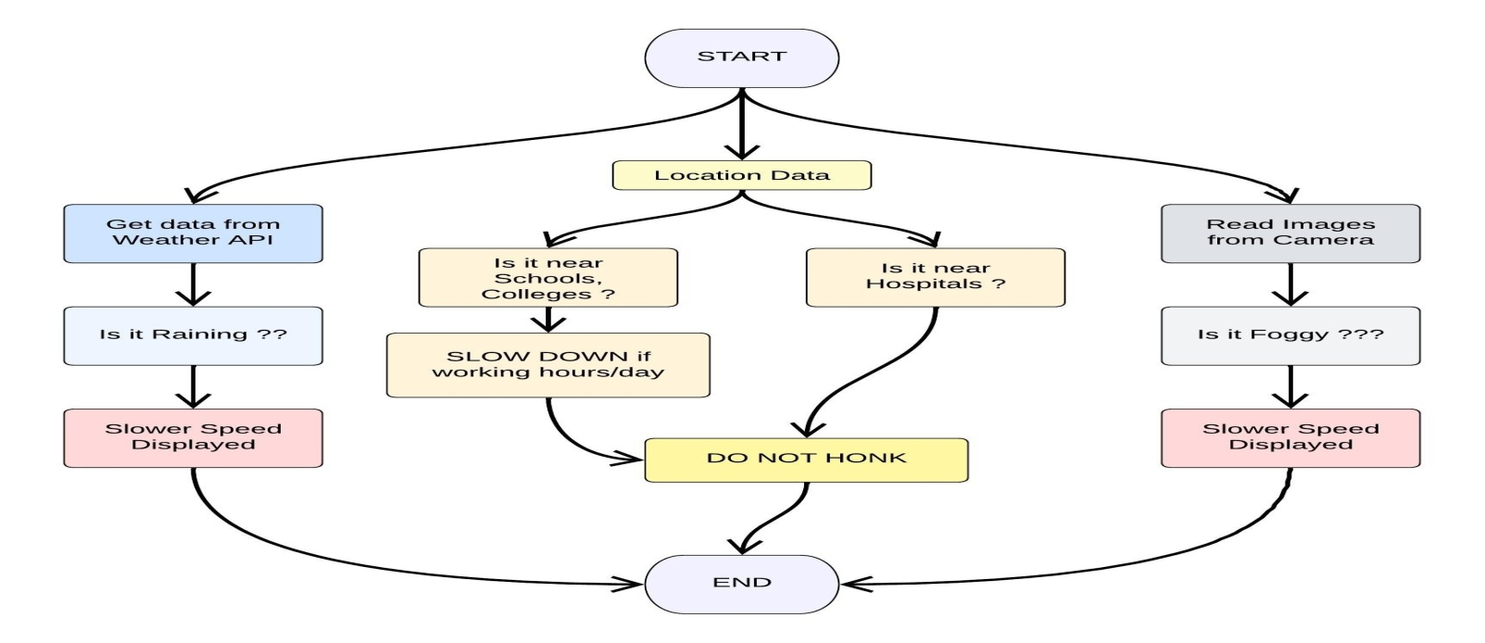
5. PROJECT DESIGN :
5.1 DATA FLOW DIAGRAM :

Slide 15
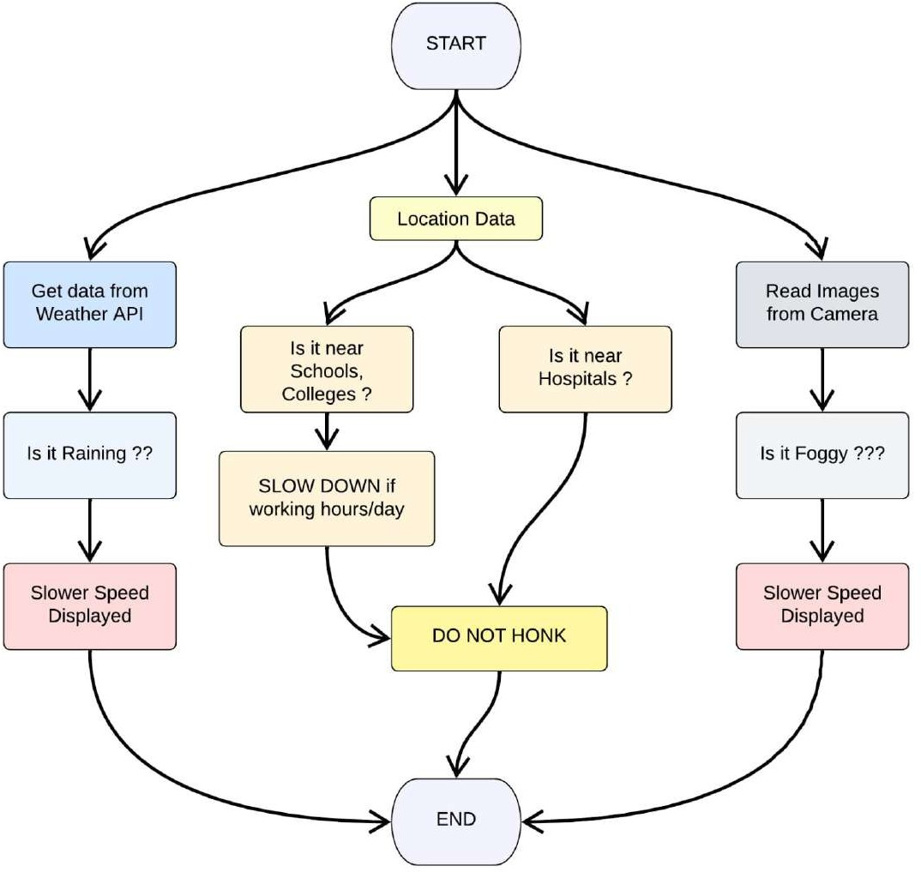
5.2 SOLUTION & TECHNICAL ARCHITECTURE :
SOLUTION ARCHITECTURE :

Slide 16
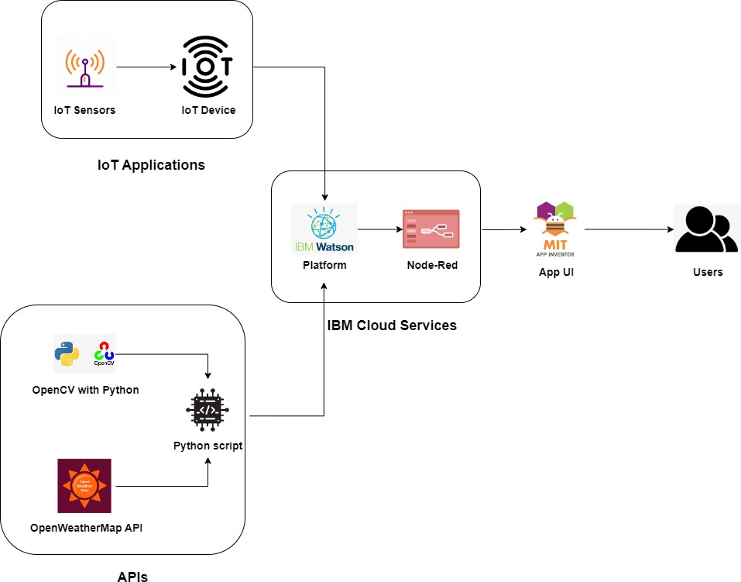
TECHNICAL ARCHITECTURE :

Slide 17
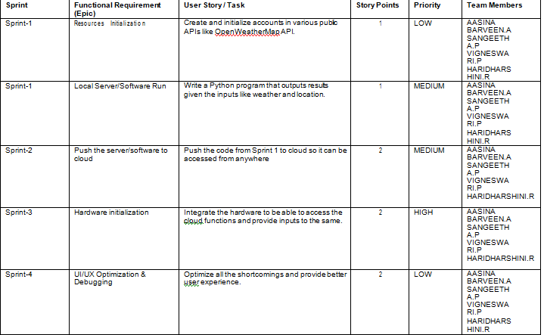
6 PROJECT PLANNING @ SCHEDULING :
6.1 SPRINT PLANNING @ ESTIMATION :

Slide 18
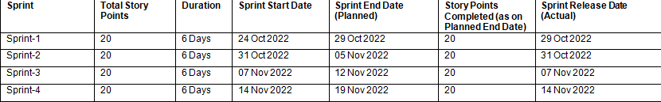
6.2 SPRINT DELIVERY SCHEDULING :

Slide 19
7.CODING @ SOLUTIONING :
7.1 FEATURE 1
# Python code
# IMPORT SECTION STARTS
import brain
# IMPORT SECTION ENDS
#.................................................
………
# USER INPUT SECTION STARTS
mylocation = “Chennai, IN”
APIKEY =
“9cd610e5fd400c74212074c7ace0d62c”
localityinfo = {

Slide 20
“schools” : {
“schoolzone” : True,
“activeTime” : [“7:00” , “17:30”]
# school active from 7 AM till 5.30 PM
},
“ hospitalsnearby” : False,
“usualspeedlimit”: 40 # in kmk/hr
}
# USER INPUT SECTION ENDS
#................................................................
………
# MICRO - CONTROLLER CODE STARTS

Slide 21
7.2 FEATURE 2
# Python code # IMPORT SECTION STARTS import brain # IMPORT SECTION ENDS # ----------------------------------------------- # USER INPUT SECTION STARTS myLocation = "Chennai,IN" APIKEY = "9cd610e5fd400c74212074c7ace0d62c" localityInfo = { "schools" : {

Slide 22
"schoolZone" : True, "activeTime" : ["7:00","17:30"] # schools active from 7 AM till 5:30 PM }, "hospitalsNearby" : False, "usualSpeedLimit" : 40 # in km/hr } # USER INPUT SECTION ENDS # ----------------------------------------------- # MICRO-CONTROLLER CODE STARTS print(brain.processConditions(myLocation,APIKEY,localityInfo)) ''' MICRO CONTROLLER CODE WILL BE ADDED IN SPRINT 2 AS PER OUR PLANNED SPRINT SCHEDULE ''' # MICRO-CONTROLLER CODE ENDS

Slide 23
8. TESTING :
8.1 TEST CASES
A Test Case is a set of actions executed to verify a particular feature or functionality of your software application. A Test Case contains test steps, test data, precondition, postcondition developed for specific test scenario to verify any requirement. The test case includes specific variables or conditions, using which a testing engineer can compare expected and actual results to determine whether a software product is functioning as per the requirements of the customer. Testing is the final verification and validation activity with in the organization itself.
.

Slide 24
WHITE BOX TESTING
White Box Testing is a testing in which in which the software tester hasknowledge of the inner workings, structure and language of the software.
Usingwhite box testingwe can derive test cases that:-
Guarantee that all independent paths within a module have been exercised atleast once.
Exercise all logical decisions on their true and false sides.
Execute all loops at their boundaries and within their operational bounds.

Slide 25
BLOCK BOX TESTING
Black Box Testing is testing the software without any knowledge of theinner workings, structure or language of the module being tested. It is a testing inwhich the software under test is treated, as a black box . The test provides inputsand responds to outputs without considering how the software works.
It uncovers adifferent class of errors in the following categories:
Incorrect or missing function.
Performance errors.
Initialization and termination errors.
Errors in objects.

Slide 26
UNIT TESTING
Unit testing is usually conducted as part of a combined code and unit testphase of the software lifecycle, although it is not uncommon for coding and unittesting to be conducted as two distinct phases: Test strategy and approach.Field testing will be performed manually and functional tests will be written indetail.
Test objectives:
All Components must work properly.
Proper coordinates should be sent by the Android app to the Arduino.
The entry screen, messages and responses must not be delayed in theAndroid.

Slide 27
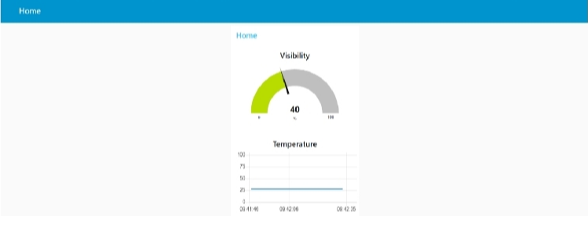
9. RESULTS :

Slide 28
10. ADVANTAGES @ DISADVANTAGES :
ADVANTAGES :
More flexible and does not revolve around a fixed schedule.
Suitable for delivery to short distance.
Acts as a feeder to other means of transport.
DISADVANTAGES :
Comparatively slower than other modes.
Unsuitable for heavy cargo.

Slide 29
11. Conclusion :
Road safety is very important for people of all ages to be safe and secure.
Everyone should follow all the rules,regulation and signs of the road traffic lights.
12. FUTURE SCOPE :
The future scope of the work is to implement the IoT device which ensures the complete solution for child safety problems.
Following are few different issues that need to be improved the system developed in this project

Slide 30
Emergencies response time reduction.
Adaptive traffic llights.
Traffic sign/signal violation warning.
Intersection coordination.
Road departure warning.

